Slide 1
Developing a Deep Learning Architecture for Predicting The Rossmann Stores’ Sales
Annual
Team 2
Gayathri Mol Shajimon
Jipa, Claudiu-Florin
Onyemelonu, Nneoma Charity
Saad, Muhammad
Lakhtyari, Halima
Mathur, Pooja

Slide 2

Overview
Rossman is a drugstore with over 3000 outlets located in 7 different European Countries.
The purpose of developing this deep learning architecture is to enable the prediction of futuristic sales within a given time frame in the stores.
From Kaggle, The data was downloaded and it was made up of 3 necessary .csv files, namely;
Train(Sales) - historical data including sales.
Test -historical data excluding sales.
Store - supplemental information about the stores.
The Deep Learning Network was developed by the pre-processing of the Sales data, the development of different deep neural architectures using the test data,
Data Dropped: Due to some missing data some columns were dropped because of their low correlation this was done on both
Data Used: Every other columns that were not dropped due to low correlation were used.
Outliers going beyond the bound were all capped and
Null values were replaced by the median.

Slide 3
Data Pre-processing
Handle outliers by capping the values, fill up missing data using the median value.
Define Date column by years months and days, Drop columns and normalize data.
Set the lower and higher percentile range
Checking for correlation using Seaborne
Data Cleaning
Correlation
Outliers/Scaling
Normalization and conversion of columns to integers

Slide 4
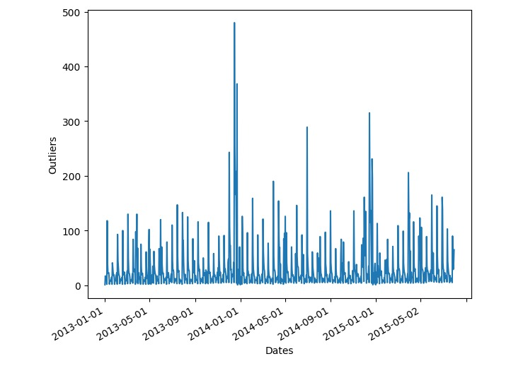
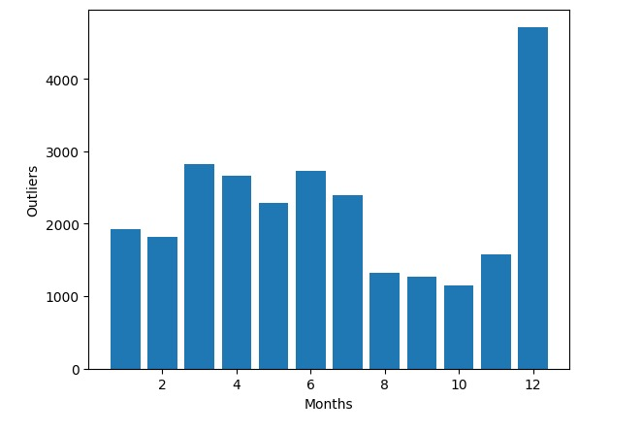
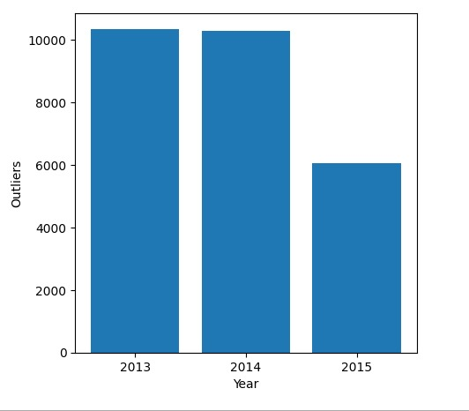
Representation of the outliers

Slide 5
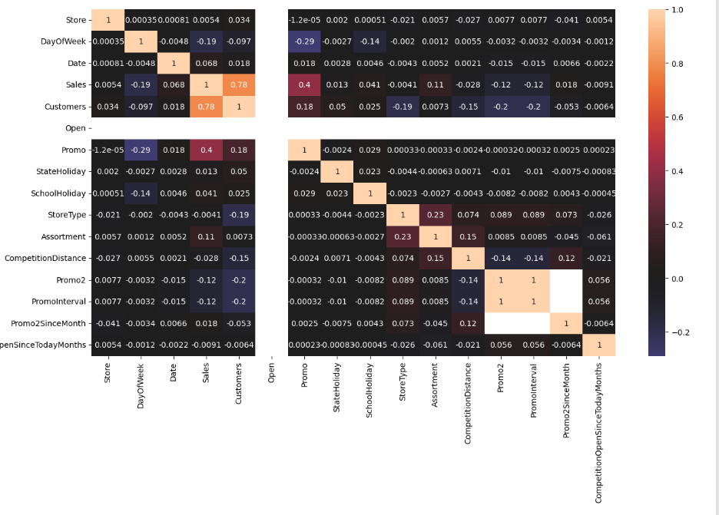
The Correlation
The Correlation

Slide 6
The Type of Deep Neural Network Used:
Linear Regression was used as an activation function for the output layer and ReLU was used for all the other layers. We also used the Mean Square Error as the Loss Function.
In the training and testing of the Model, we used RMSprop as the optimizer for tuning the biases and the weights of the Neurons.

Slide 7
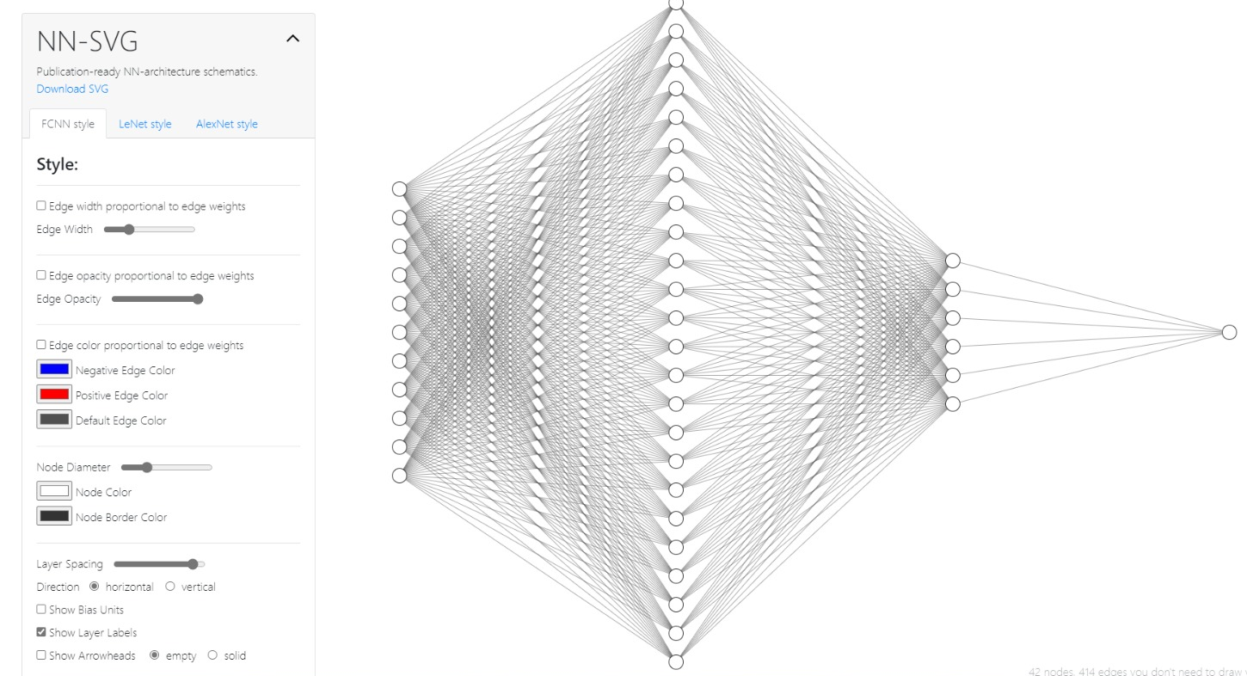
The Architecture
j

Slide 8
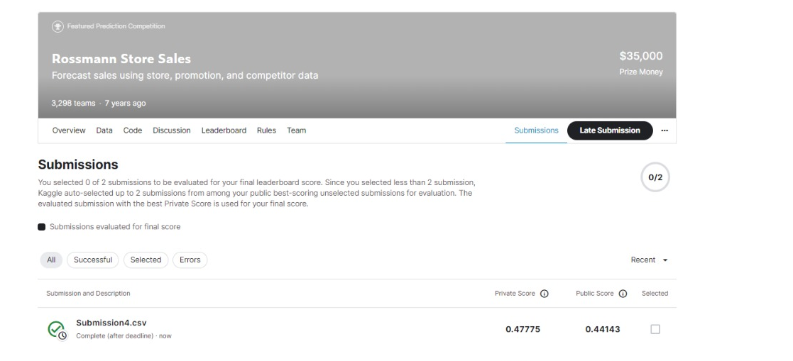
Kaggle Score
After the upload of our submission data to Kaggle,
a private score of 0.47775 and a public score of 0.44143 were generated.

Slide 9
Roles/Responsibilities
Gayathri Mol Shajimon and Onyemelonu Nneoma Charity
Lakhtyari Halima and Saad Muhammad
Data Pre-processing
Preparation of the slides
Testing of different Deep Learning Architectures
Jipa Claudiu-Florin & Mathur Pooja
Everyone
Deep Learning Architecture Tuning
Group Discussion
Decisions

Slide 10
Thank you
In Conclusion, this Deep Learning Architecture was the best architecture we could build to solve the Rossmann Stores’ Sales problem.

